Slide 1
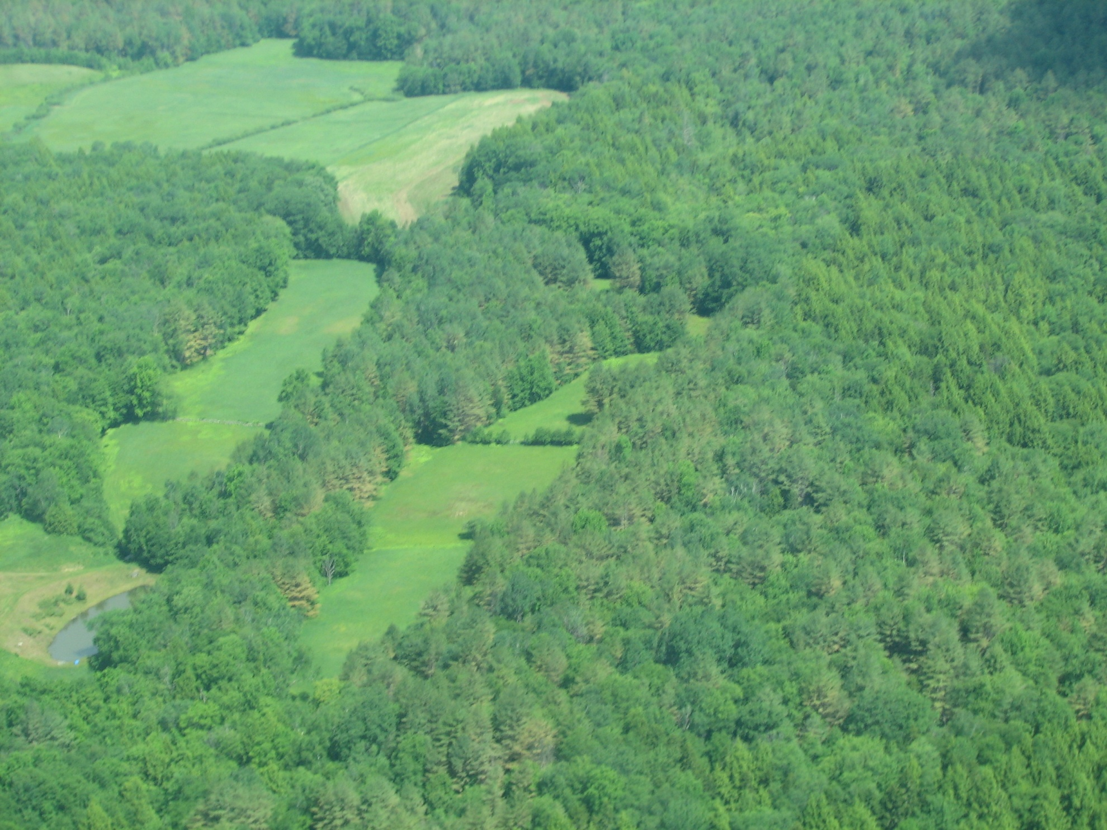
Exploring Stress in the White Pines
Forest Watch November 2012
Forest Watch thanks Dr. Isabel Munck, US Dept. of Agriculture Forest Service, Northeastern Area, State and Private Forestry, for sharing her research regarding fungal predation on the white pines. This photo, taken by the Vermont Division of Forestry, shows stressed white pine foliage, where tree tops appear brown.

Slide 2
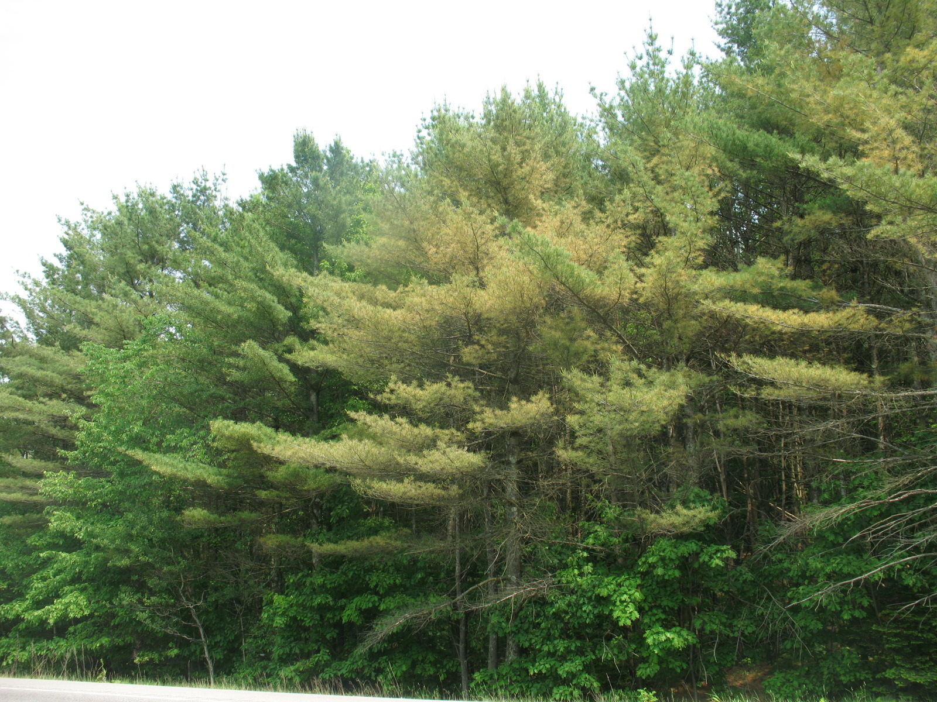
Across Vermont, New Hampshire and Maine, Forest Watch teachers and timberland owners are noticing a curious browning of needles. Tree tops look thin. And pines are dropping massive numbers of needles. It began in June 2010.
6/30/2011

Slide 3
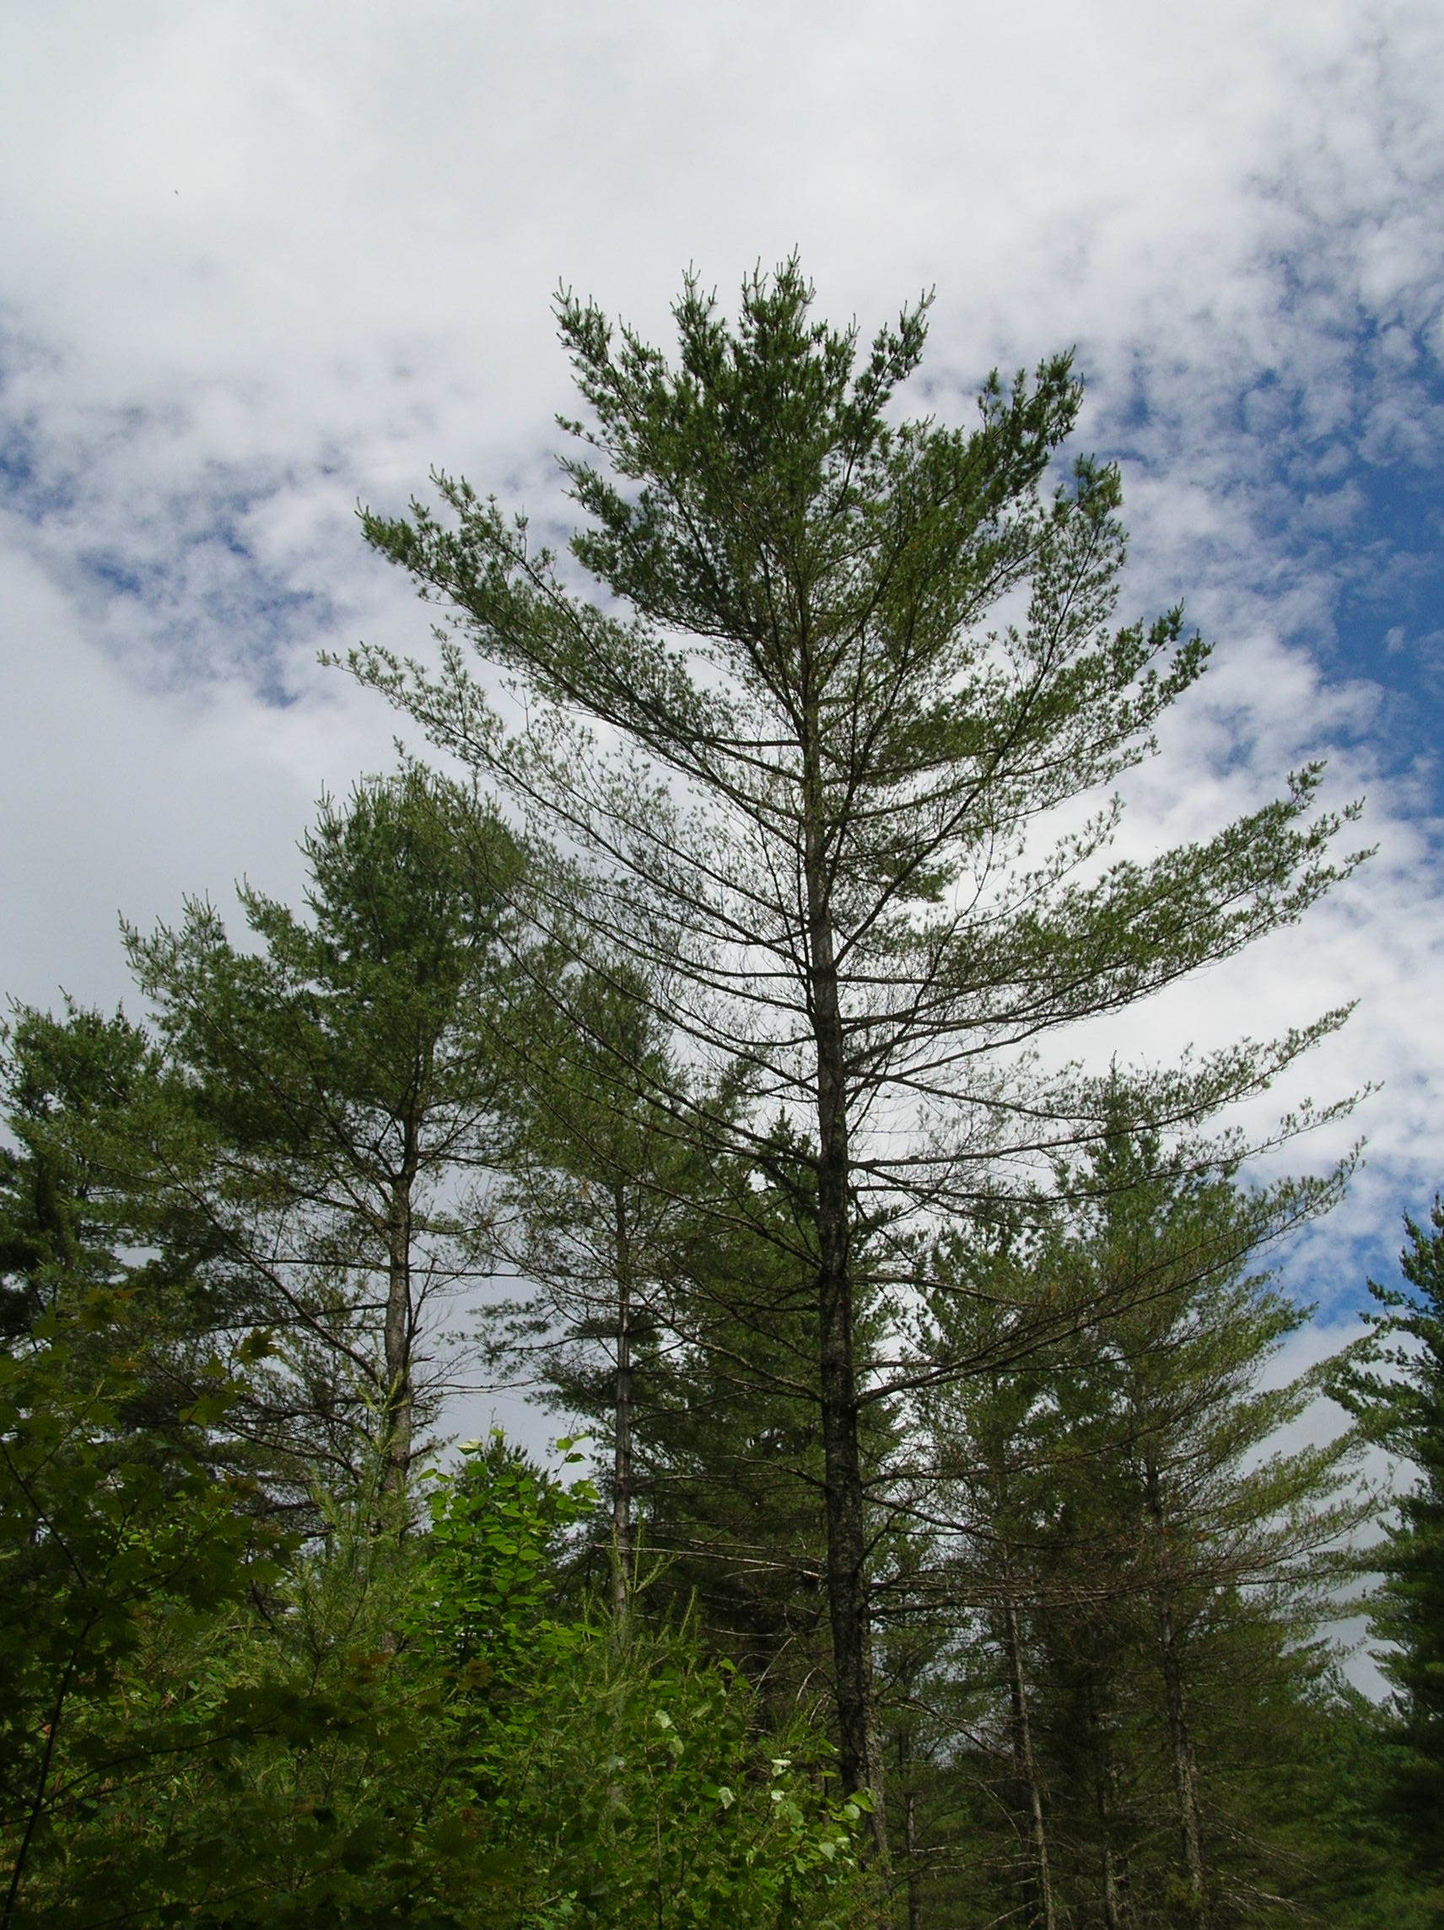
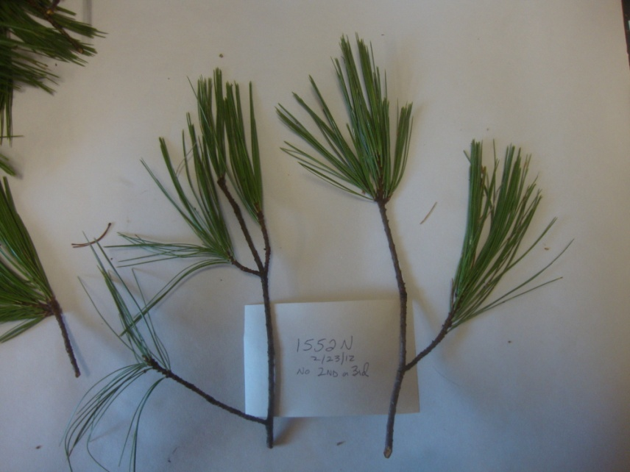
White pine foliage looks thinner than usual.
When we look at twigs, many trees have no fourth, third or second year needles.
6/30/2011

Slide 4
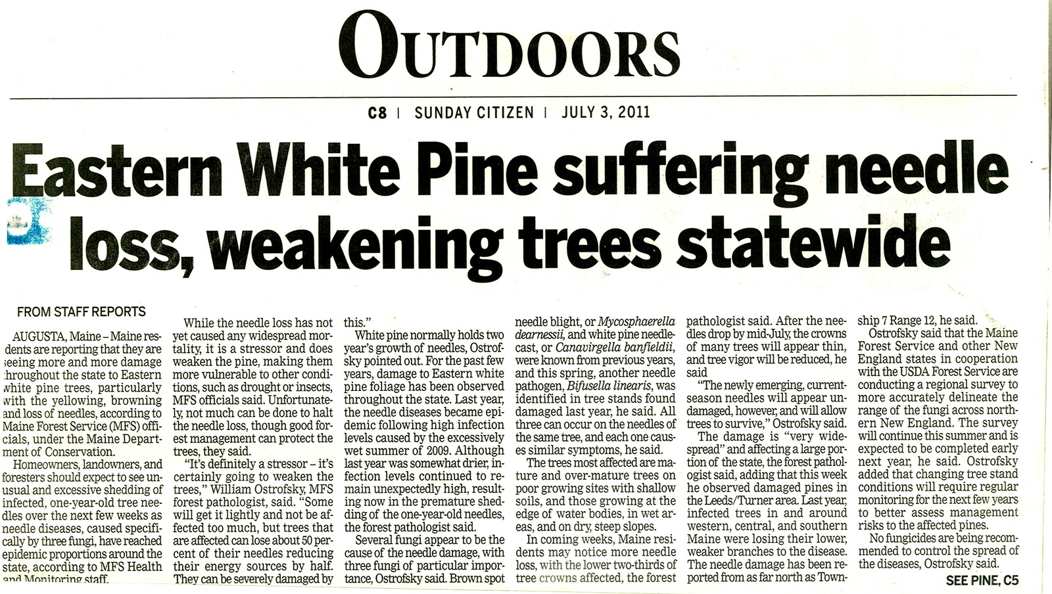
With the first needle cast in June 2010 and another in June 2011, citizens called Extension agents and state foresters asking what is going on.

Slide 5
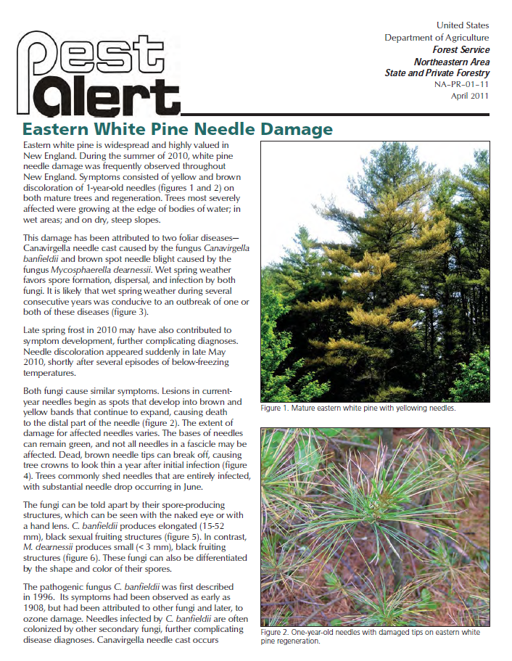
Even in 2010, Extension foresters and state pathologists identified fungi as a probable cause of heavy needle cast. Numerous fungi are known to cause needle cast even though such damage usually occurs in September and even though fungi rarely damaged more than 1% of the pines.

Slide 6
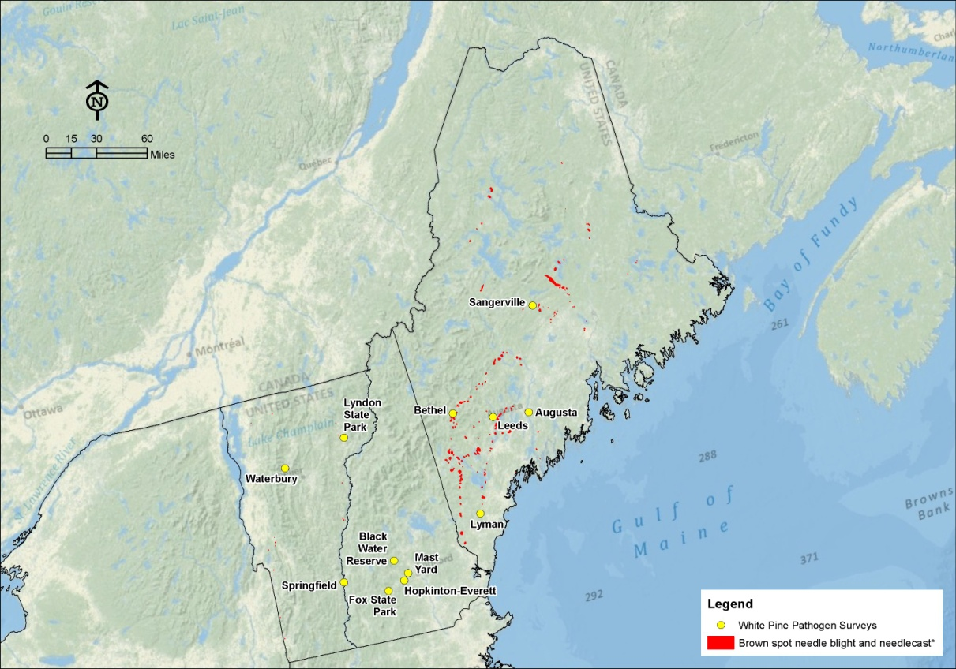
A study of the fungi was launched by the U.S. Forest Service in collaboration with state plant pathologists in Vermont, New Hampshire and Maine. Sites on cooperating landowners pine stands were identified from existing Forest Inventory & Analysis cooperators.

Slide 7
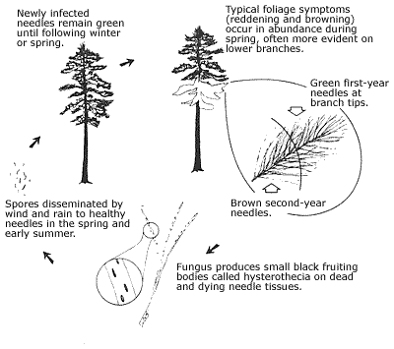
Needle casts
Munck and her team researched the life cycles of each fungi they found so they could know at what time various fungal forms would be visible.
http://www.floridaforestservice.com/publications/Insects_and_Diseases/td_cf_needle_cast_fig10.html

Slide 8
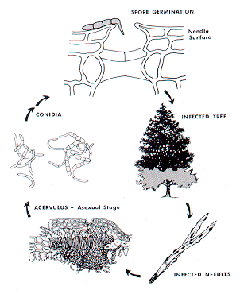
Brown spot needle blight- Mycosphaerella dearnesii
The chief culprit, brown spit needle blight produces spores each spring in black fruiting bodies which appear on second or third-year needles. These needles will be cast by July. Before they drop from the tree, they may infect emerging new needles at the twig tip.
http://www.na.fs.fed.us/spfo/pubs/fidls/br_spot_pines/brown-spot.htm

Slide 9
Methods of Fungal Research
Samples collected in 4/2011 and 6/2011 from 13 sites in VT, NH, & ME damaged in 2010
3-5 trees sampled per site (1 L zip-lock bag per tree)
All branch tips were examined
Needles from a representative branch/tree incubated for 24-48 hr at 25 ̊C
Fruiting bodies examined & photographed

Slide 10
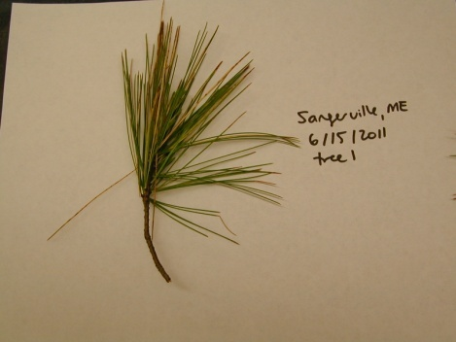
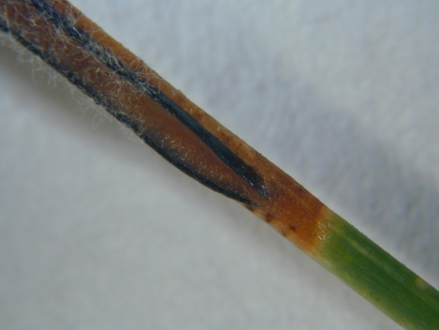
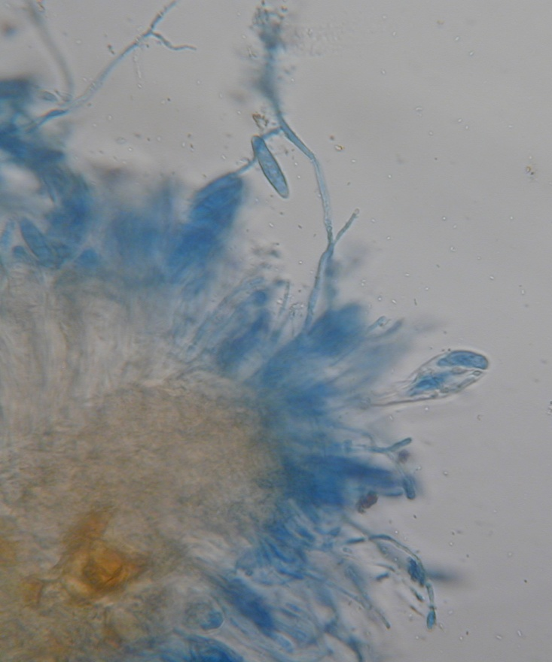
The Munck Study examined needles, fruiting bodies and microscopic views of the fungal hyphae and spores.
Canavirgella needle cast caused by
Canavirgella bandfieldii

Slide 11
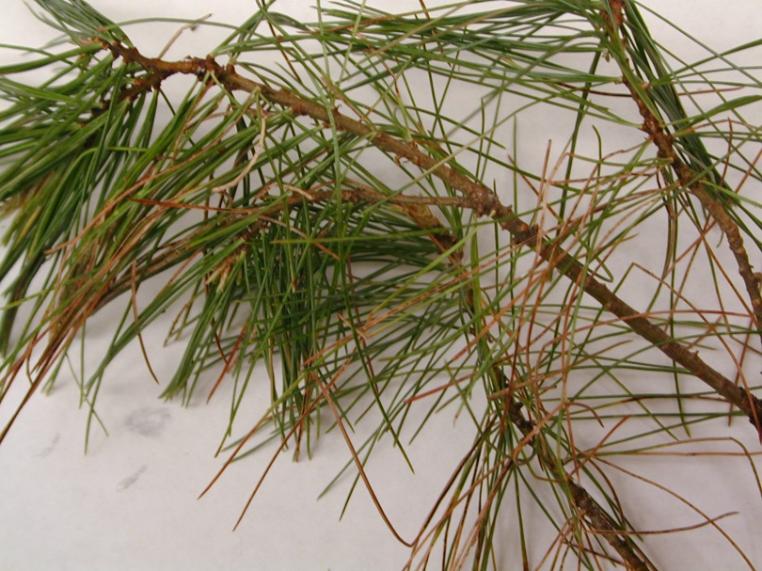
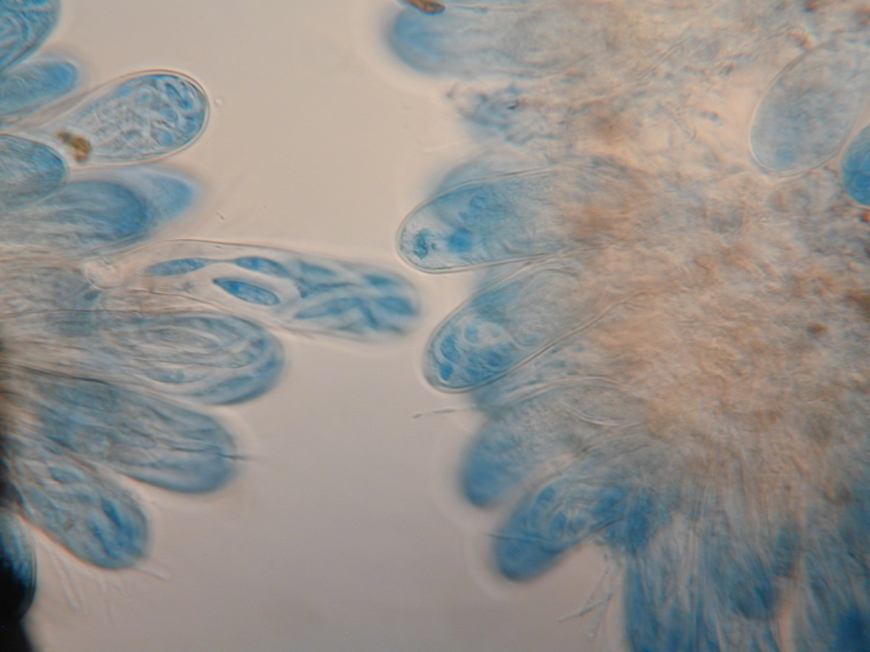
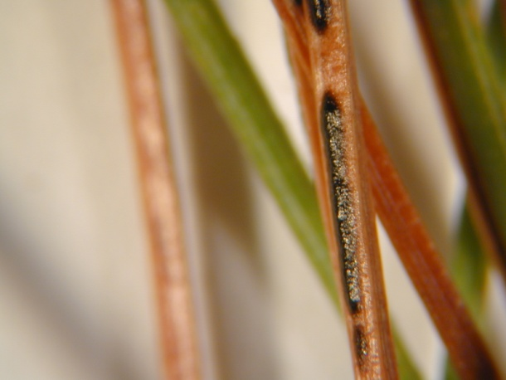
The subtle differences in fruiting body and spore sacks can help identify the species.
Bifusella needle cast caused by
Bifusella linearis

Slide 12
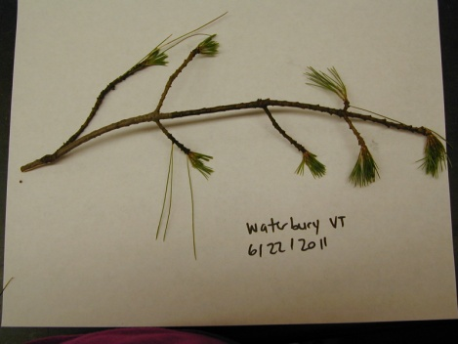
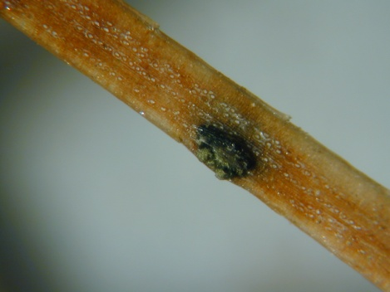
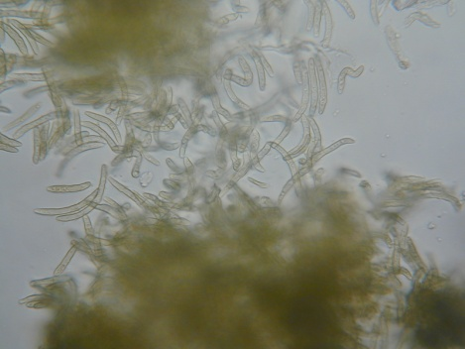
Three main fungi were identified. But several others may also be infesting the pines.
Brown spot needle blight caused by
Mycosphaerella dearnessii

Slide 13
Conclusions from 2011
At least 3 pathogenic fungi present at the same site and more than one pathogen on the same tree
Mycosphaerella dearnessii was the most frequently observed & widely distributed pathogen
Mycosphaerella dearnessii most constantly associated with chlorosis and defoliation

Slide 14
Munck et al. conclude that …
Damage in 2012 more severe than 2011 in VT, NH, and MA
Damage in 2012 less severe than 2011 in ME
WPND is also a problem in Canada and Europe.

Slide 15
WPND follow up
Kirk Broder’s Lab at UNH (cultures & DNA) confirmed M. dearnessii is most frequent pathogen associated with needle damage
Several other fungi (potential pathogens) were also isolated from symptomatic needles
Seedlings will be inoculated with these isolates
Predictive climate model will be developed
Tagged trees will be monitored/cored

Slide 16
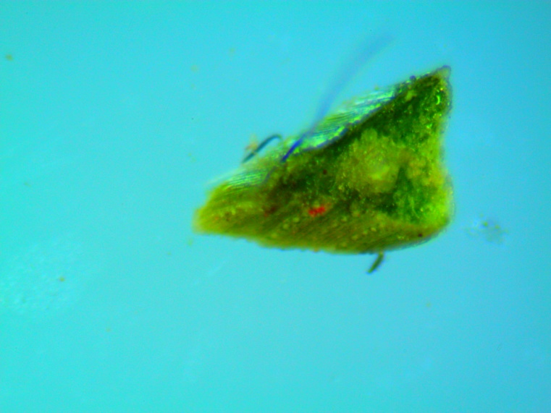
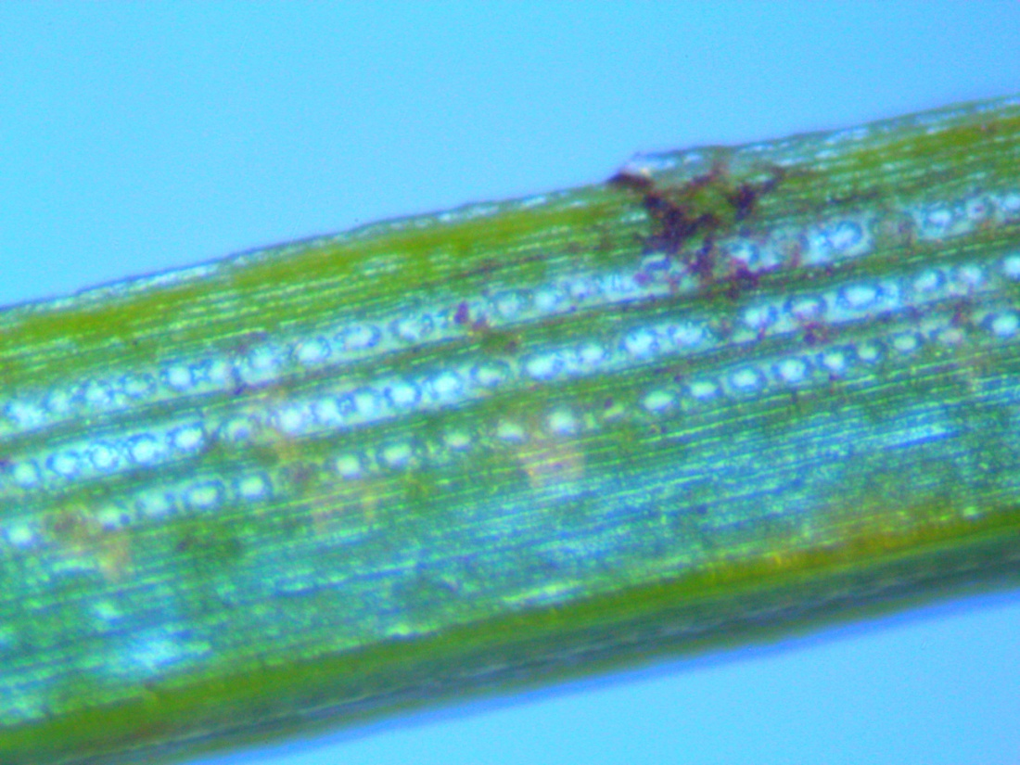
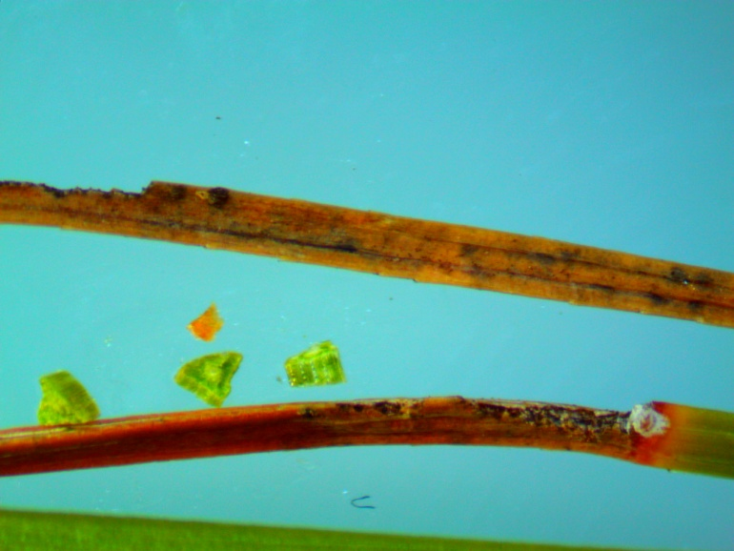
Meanwhile Forest Watch sees the damage.
At the Dublin School, Dublin NH, 2nd Year Needles showed extreme drying and browning and signs of fungal hyphae, black hairs at far right.

Slide 18
In 2012, REIPs begin to show some loss of chlorophyll in 1st year needles.
Dublin’s two worst trees have REIPs of 719.3 and 714.6 in first year needles, very unusual. No tree is higher than 725.4.

Slide 19
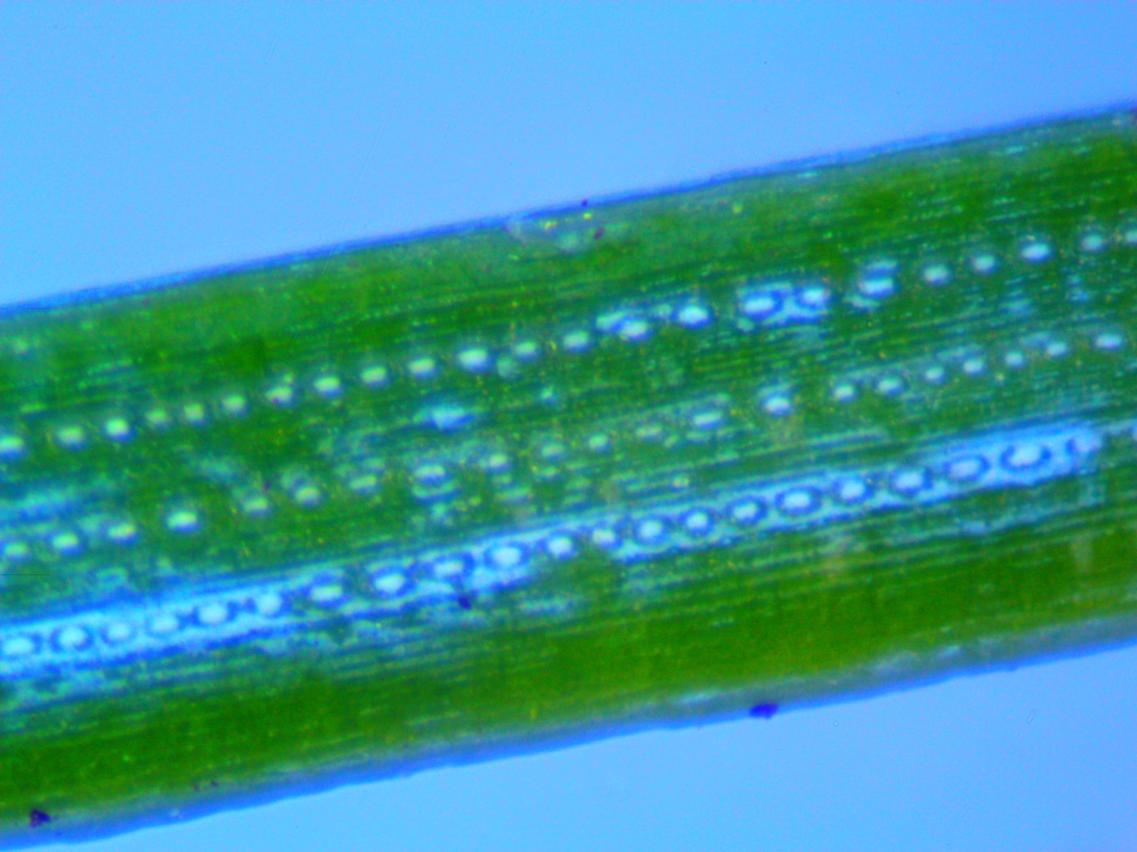
Healthy Needle- Dublin’s 1942
Healthy 1st year needles show no fungal damage. In 2011, even trees that had cast 2nd and 3rd year needles showed no damage on 1st year needles.

Slide 20
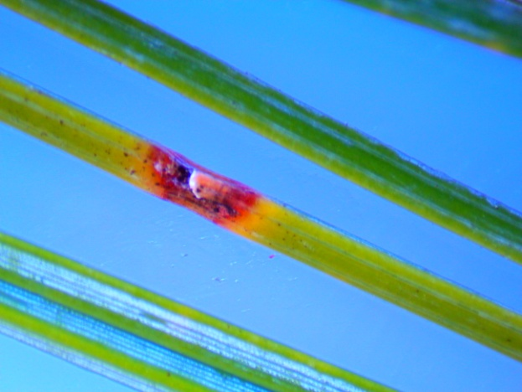
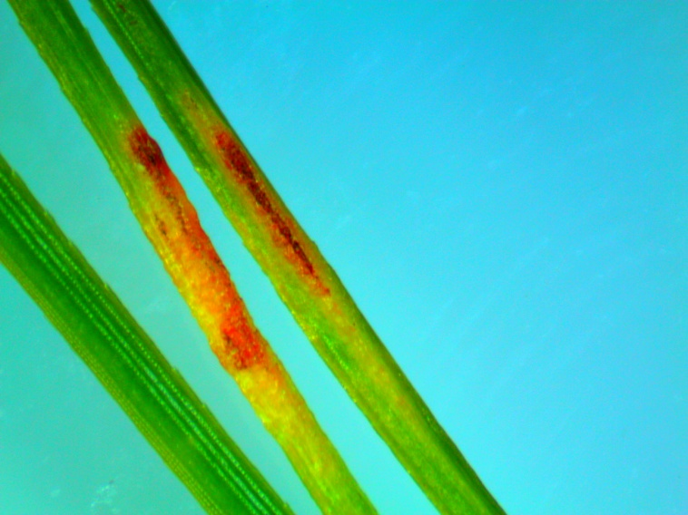
Dublin School, Dublin NH
1st Year Needles showed fungal infection.
Forest Watch is now finding water stress, early senescence, visible damage and slight drops in REIPs on new needles. The damage appears to be worsening.

Slide 21
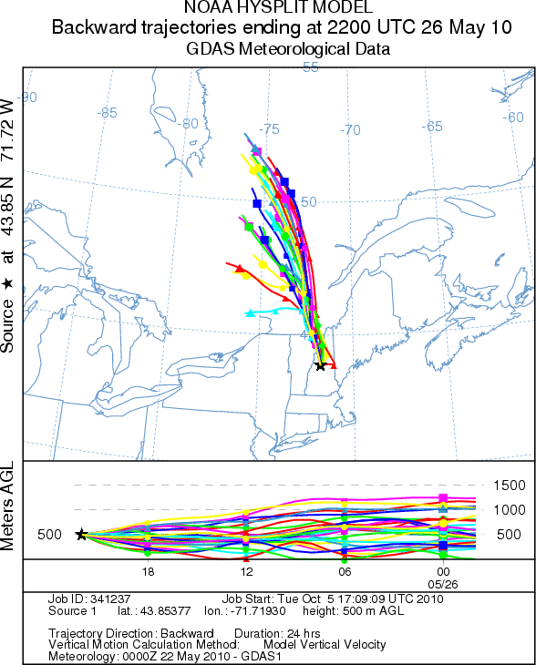
What stress could make the pines susceptible to the fungi?
We hypothesize that an unusual atmospheric pollution event, such as one that occurred on May 26, 2010, may have been the initial stressor.
Continued pollution occurrences, such as long winter low pressure periods which bring a mix of ozone, sulfate and nitrate into the region, may add to that damage.
We are researching these possibilities.

